Slide 1
Building a streaming incremental view maintenance engine with Calcite
Mihai Budiu - VMware Research
March 15, 2023
Apache Calcite Online Meetup

Slide 2

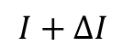
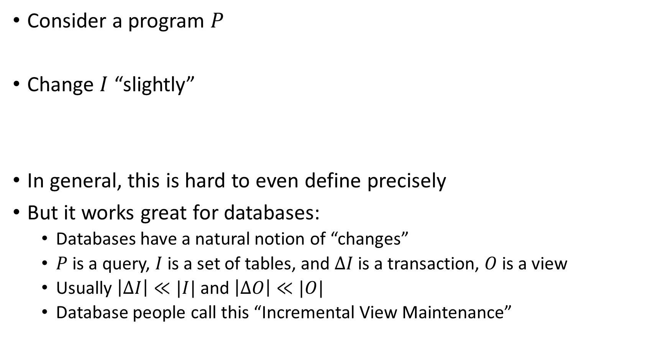
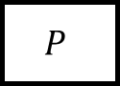
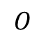
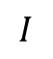
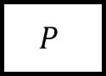
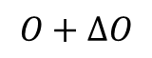
What is incremental computation?
Consider a program $P$
Change $I$ “slightly”
In general, this is hard to even define precisely
But it works great for databases:
Databases have a natural notion of “changes”
$P$ is a query, $I$ is a set of tables, and $ΔI$ is a transaction, $O$ is a view
Usually $\left|ΔI\right|≪|I|$ and $\left|ΔO\right|≪|O|$
Database people call this “Incremental View Maintenance”
$$I$$
$$P$$
$$O$$
reuse
$$I+ΔI$$
$$P$$
$$O+ΔO$$

Slide 3

Outline
Theory: streaming incremental computations
Practice: SQL streaming implementation using Calcite

Slide 4
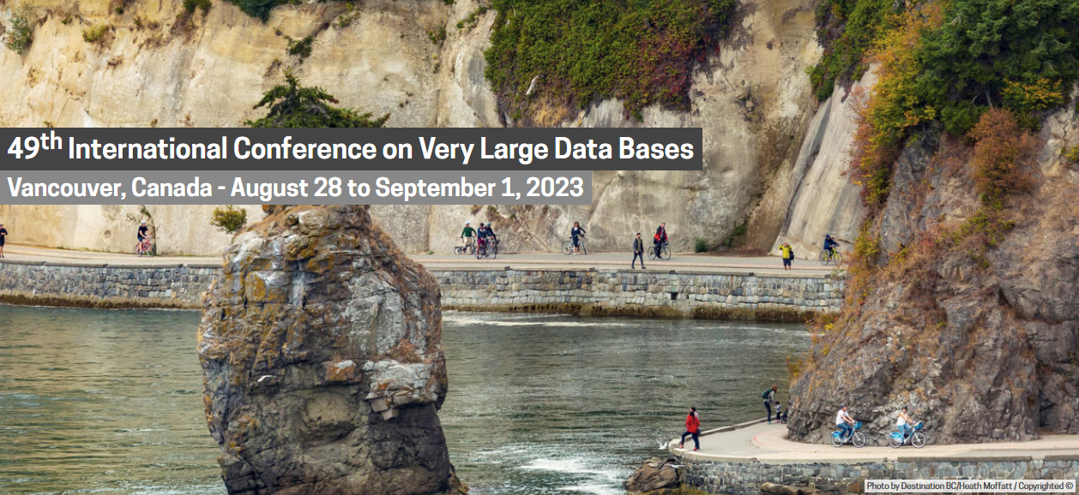
If you want to know more
DBSP: Automatic Incremental View Maintenance for Rich Query Languages Mihai Budiu, Tej Chajed, Frank McSherry, Leonid Ryzhyk, Val Tannen VLDB 2023
(camera-ready will be available next Monday)

Slide 5

A simple streaming language called DBSP
Four (4) operators
A new definition of incremental computation using DBSP
An algorithm converting an arbitrary DBSP program to an incremental DBSP program
A recipe implementing queries in DBSP
2 operators needed for SQL
2 for recursive queries (not in this talk)

Slide 6
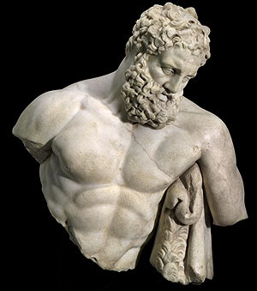
DBSP is powerful
It can model a rich class of database queries:
Relational (select, project, join, union, difference)
Computations on sets, bags, multisets
Nested relations (group-by, unnest)
Aggregation
Recursion (monotonic and non-monotonic)
Stratified negation
Streaming computations (joins, window aggregates)
More?
Corollary: we get automatically incremental evaluation for all these
SQL
Datalog
CQL

Slide 7

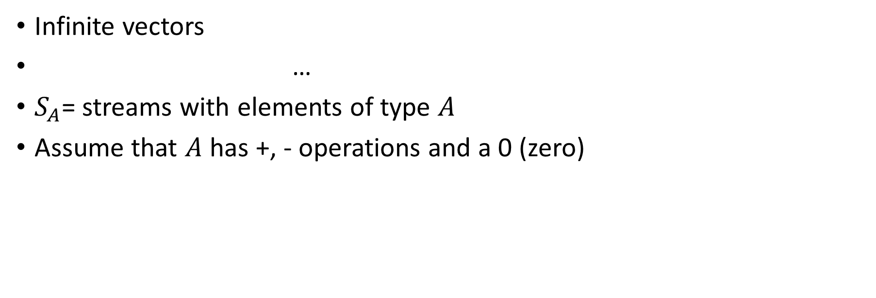
Streams
Infinite vectors
…
$S_{A}$= streams with elements of type $A$
Assume that $A$ has +, - operations and a 0 (zero)
0
1
2
1
0
-1
-2
-1

Slide 8
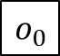
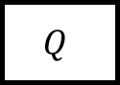
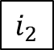
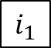
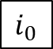
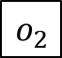
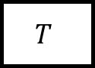
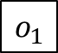
Stream operators
Arrows = streams
boxes = operators
$$i_{0}$$
$$i_{1}$$
$$i_{2}$$
…
$$Q$$
$$o_{0}$$
$$o_{1}$$
$$o_{2}$$
…
…
$$T$$
…
…

Slide 9
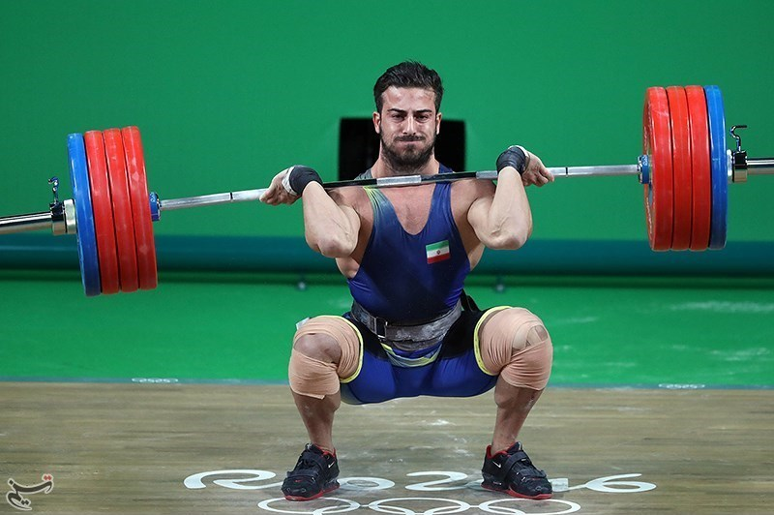
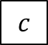
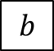
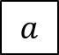
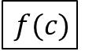
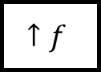
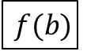
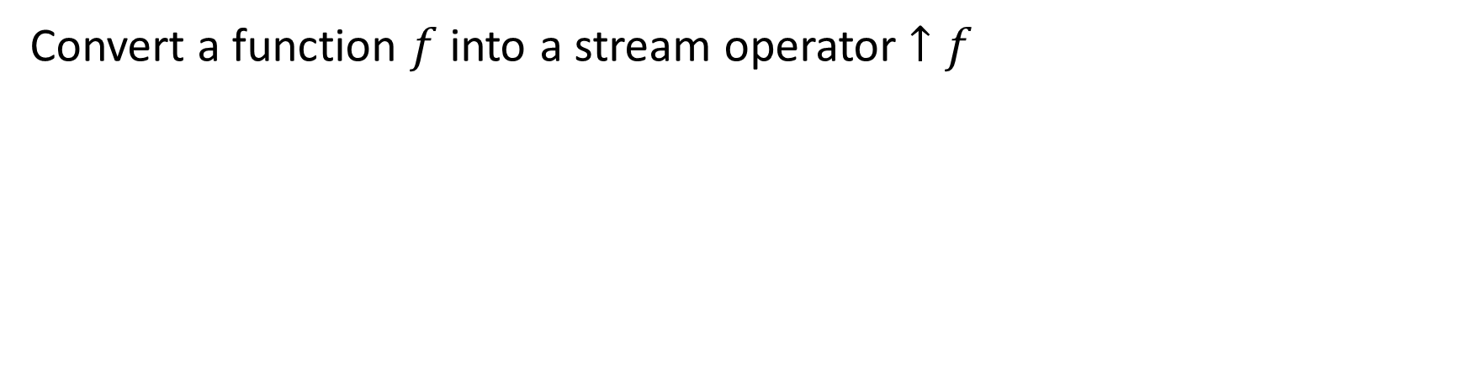
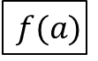
Lifting
Convert a function $f$ into a stream operator $↑f$
$$a$$
$$b$$
$$c$$
…
$$↑f$$
$$f(a)$$
$$f(b)$$
$$f(c)$$
…

Slide 10
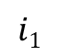
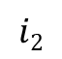
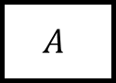
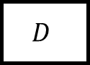
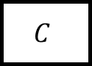
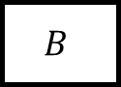
Chaining operators into circuits
“Dataflow graphs”
$$i1$$
$$A$$
$$B$$
$$C$$
o
$$i2$$
$$D$$

Slide 11
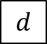
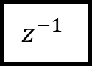
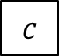
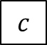

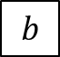
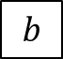
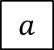
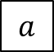
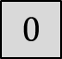
Delay ($z^{−1}$ )
Output is input stream delayed by one step
First value is 0
$$a$$
$$b$$
$$c$$
$$d$$
…
$$z^{−1}$$
$$0$$
$$a$$
$$b$$
$$c$$
…

Slide 12
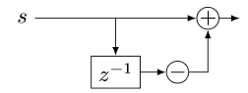
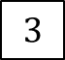
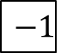
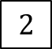
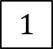
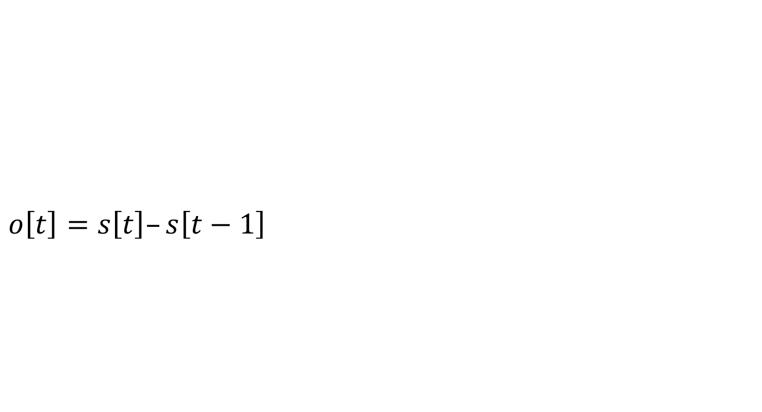
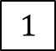

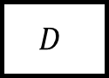


Computing deltas
$$o\left[t\right]=s\left[t\right]–s\left[t−1\right]$$
o
o is the stream of changes of s
$$1$$
$$2$$
$$3$$
$$2$$
…
$$D$$
$$1$$
$$1$$
$$1$$
$$−1$$
…
stream of deltas

Slide 13










Integration
$o[0] =s[0]$
$o[t] =s[t] + o[t−1]$
$o\left[t\right]=s\left[0\right]+s\left[1\right]+ …+s[t]$
o
If s is a stream of changes…
… then o is the original stream
$$1$$
$$1$$
$$1$$
$$−1$$
…
$$I$$
$$1$$
$$2$$
3
$$2$$
…
stream of changes

Slide 14


$D$ and $I$ are inverses
$$Δs$$

Slide 15










All databases are streaming databases!
Consider a database $DB$, a set of tables
A committed transaction is a change to $DB$
The set of linearized transactions define $T,$ a stream of changes to $DB$
$T[t]$is the $t$-th transaction
$DB$ is a stream of database snapshots
$DB[t]$ is the contents of the database after $t$ transactions have been executed
$DB[t] = I(T)[t$]
$$T_{0}$$
$$T_{1}$$
$$T_{2}$$
$$T_{3}$$
…
$$I$$
$${DB}_{0}$$
$${DB}_{1}$$
$${DB}_{2}$$
$${DB}_{3}$$
…

Slide 16












Views
Let $Q$ be a query defining a view $V$, e.g.:
CREATE VIEW V AS SELECT * FROM T WHERE Age >= 10
$V[t]=Q\left(DB[t]\right)$
$V$ is a stream of view snapshots:
$$V= ↑Q(DB)$$
$$↑Q$$
$$V_{0}$$
$$V_{1}$$
$$V_{2}$$
$$V_{3}$$
…
Versions of $V$
Versions of $DB$
$${DB}_{0}$$
$${DB}_{1}$$
$${DB}_{2}$$
$${DB}_{3}$$
…

Slide 17













Incremental view maintenance of view $V$
This is our definition of IVM
The standard DB definition does not include the last D
This definition is much better:
It is compositional
Inputs and outputs are both deltas
$${(↑Q)}^{Δ}$$
$$T_{0}$$
$$T_{1}$$
$$T_{2}$$
$$T_{3}$$
…
$$I$$
$$↑Q$$
D
$$ΔV_{0}$$
$$ΔV_{1}$$
$$ΔV_{2}$$
$$ΔV_{3}$$
…
Changes to $DB$
Changes to $V$
$$V_{0}$$
$$V_{1}$$
$$V_{2}$$
$$V_{3}$$
…
Versions of $V$
Versions of $DB$
$${DB}_{0}$$
$${DB}_{1}$$
$${DB}_{2}$$
$${DB}_{3}$$
…

Slide 18










Incremental queries are streaming systems
$${Δi}_{0}$$
$${Δi}_{1}$$
$${Δi}_{2}$$
$${Δi}_{3}$$
…
$$Q^{Δ}$$
$$Δo_{0}$$
$$Δo_{1}$$
$$Δo_{2}$$
$$Δo_{3}$$
…
state
$Q^{Δ}$ is a streaming system:
it runs forever
it maintains internal state (even if $Q$ is stateless)
the state is stored in the delay operators (inside $I$ and $D$)

Slide 19

























Linear operators: $Q(a+b) = Q(a) + Q(b)$
For a linear operator $Q$ we have $Q=Q^{Δ}$
Why is this better?
Optimized:
A speedup of $O(\left|DB\right|/|T|)$
$$T_{0}$$
$$T_{1}$$
$$T_{2}$$
$$T_{3}$$
…
$$I$$
$$Q$$
D
$$ΔV_{0}$$
$$ΔV_{1}$$
$$ΔV_{2}$$
$$ΔV_{3}$$
…
$${DB}_{0}$$
$${DB}_{1}$$
$${DB}_{2}$$
$${DB}_{3}$$
…
$$T_{0}$$
$$T_{1}$$
$$T_{2}$$
$$T_{3}$$
…
$$Q$$
$$ΔV_{0}$$
$$ΔV_{1}$$
$$ΔV_{2}$$
$$ΔV_{3}$$
…

Slide 20
Example linear query
CREATE VIEW V AS SELECT * FROM T WHERE Age >= 10
“Shardable” queries
You don’t need to know what’s in T to compute the changes to V
Most relational queries use linear operators!

Slide 21






The chain rule (structural recursion)
$$(Q_{2}{∘Q_{1})}^{Δ}=Q_{2}^{Δ}∘Q_{1}^{Δ}$$
Proof by pictures:
We can incrementalize a complex circuit by incrementalizing each component independently
$$⇔$$
$$⇔$$
$$⇔$$

Slide 22
Let’s apply this to a DB
We need +, -, and 0 operations for a database

Slide 23


$ℤ$-sets (also called $ℤ$-relations)
Each row has an integer weight
The weight can be positive, zero, or negative
Can represent both tables and changes to tables
Positive weight => row added
Negative weight => row removed
Generalize sets and multisets
Classic DB table = $ℤ$-set where all weights are 1
Name | Age | Weight
Mike | 10 | 1
John | 12 | 3
Amy | 8 | -1
Chris | 10 | 2
tuples

Slide 24


The distinct operator
“Converts” a $ℤ$-set into a set
Throws away rows with negative weights
Name | Weight
Dan | 1
John | 3
Amy | -1
Chris | 3
Name | Weight
Dan | 1
John | 1
Chris | 1
$$distinct\left( \right)=$$

Slide 25



Relational algebra using $ℤ$-set operations
Recursively defined on query structure
Many operations require a $distinct$
(But many can be removed)
The other operations are all linear or bilinear

Slide 26



Bilinear operators
(Lifted) join
From distributivity:$Δ\left(A×B\right)=\left(A×ΔB\right)+\left(ΔA×B\right)+\left(ΔA×ΔB\right)$
Speed-up is $O(\frac{\left|A\right|}{\left|ΔA\right|}+\frac{\left|B\right|}{\left|ΔB\right|})$
$$⇔$$

Slide 27
Outline
Theory: streaming incremental computations
Practice: SQL streaming implementation using Calcite

Slide 28

DBSP Library
https://github.com/vmware/database-stream-processor
MIT license
Rust framework to describe DBSP circuits
Support for relational algebra, nested relations, aggregates, etc.
Implementation of the basic incremental operators
Multi-core execution
Fast

Slide 29

Nexmark queries benchmark
(queries manually written in DBSP Rust)

Slide 30

SQL to DBSP compiler
https://github.com/vmware/sql-to-dbsp-compiler
MIT license
Generates Rust programs using DBSP as a runtime
Based on Apache Calcite

Slide 31
Streaming systems in SQL
CREATE VIEW V AS SELECT …
CREATE TABLE T ( … ) CREATE TABLE S ( … )
T
V
Dataflow graph
CREATE VIEW W AS SELECT …
S
W

Slide 32


Compilation workflow
SQL runtime
$Δ$T
Calcite SQL parser (DDL)
SqlToRel
Optimize (Hep)
DBSP circuit (non-inc)
DBSP
circuit (inc)
rustc
SQL
exe
$Δ$V
Schema
DBSP runtime
Java
Rust

Slide 33

Status
About 10 person-month effort
Support for all of “core” SQL
Some window operators (OVER)
Under construction
“exotic” datatypes: DATE WITH TIMEZONE, BLOBS, JSON, Geospatial, Maps
Recursive queries
Support for other streaming notions (watermarks, finalization, etc.)
More complex window operators (tumbling, hopping, session, etc)
More functions in the SQL runtime
Supporting some UDF language

Slide 34

Calcite Plan Optimizations
Streaming systems generate plans before data is available!
No cost model or data statistics
Whatever plan you pass to DBSP, that’s what it runs!
In principle any optimizer would work
But we want to avoid bugs in some Calcite optimization Rules
Currently applying:
Decorrelate queries
Join order
Constant folding (*_REDUCE_EXPRESSIONS)
Empty collections (PruneEmptyRules)
Distinct aggregates to joins
Dead code (*_REMOVE)

Slide 35

Testing
SqlLogicTest (completed)
From sqlite
7M+ tests
No corner cases; only INTEGER, STRING, and DOUBLE
We use a real database for DDL & DML
We only compile and test the queries
We fail 2 different tests
Postgres test suite (in progress)
Manually rewriting tests to Calcite dialect
Finding subtle semantics differences

Slide 36
The failing tests in sqllogictest
SELECT DISTINCT - + COUNT( * ) FROM tab1 AS cor0 WHERE NOT - col2 BETWEEN + col0 / 63 + 22 AND + - col2 * - col1 * - col2 * + col2 * + col1 * + - col2 * + + col0
Multiplication overflows at runtime
In MySQL INT * INT is BIGINT
In Calcite INT * INT is INT
SELECT COALESCE ( COUNT( * ), - 92 DIV 0 + - - 43 )
Calcite typechecks “-92 DIV 0” as non-nullable

Slide 37

SQL Syntax
DDL and BABEL parsers are complementary
DDL has CREATE statements
BABEL supports many useful functions
We want both at the same time
MySQL syntax has oddities
PRIMARY KEY
SIGNED for INTEGER,
DIV for /, etc.

Slide 38
SQL Semantics
The SQL spec has many undefined behaviors
Many dialects don’t even seem to respect the standard
In a streaming system you don’t really want runtime exceptions
We prefer a semantics where bad computations return NULL instead
Our pipelines are fully deterministic
We do not want to support NOW() or RAND()
These can be transformed into input streams instead, perhaps automatically

Slide 39

Static and dynamic semantics
Constant expressions are evaluated by Calcite
Using a Java-based evaluator
Which depends on the Java type system
So it is difficult to add non-Java datatypes, e.g., UNSIGNED
Other expressions are evaluated by the runtime
The results should agree
The runtime cannot unilaterally choose a semantics

Slide 40

Should Calcite support input SQL dialects?
Calcite is amazingly flexible, but not infinitely flexible
E.g., in Postgres the DOW function returns 0 for Monday
But in calcite it returns 1
It would be nice if one could specify the “input dialect” in Calcite
Which would choose automatically
The type inference rules
The set of datatypes supported
The expression evaluation rules
The set of functions supported
… to be compatible with the respective dialect
But this may be a monumental effort

Slide 41
Summary
Streaming systems run forever
A table is the integral of a stream
A transaction is the delta of a database
The right definition of IVM: computing changes to views given changes to tables
IVM systems are streaming systems
Almost any query has an efficient incremental implementation
The algorithm to incrementalize a given query is plan trivial:
Just incrementalize each primitive operator in the query
(Recursive queries get a bit more complicated. Only a bit.)
We built all this stuff as O/S
If you have a streaming or IVM problem, consider trying DBSP

Slide 42

stream
DB
IVM
IVM

Slide 43
Extra slides

Slide 44



Multiple inputs
This generalizes to operators with multiple inputs or outputs
E.g., for a binary stream operator $T:S_{A_{0}}×S_{A_{1}}→S_{B}$
$$T^{Δ}$$

Slide 45

Complex Relational Example
CREATE VIEW V AS SELECT DISTINCT a.x, b.y FROM ( SELECT t1.x , t1.id FROM t1 WHERE t1.a > 2 ) a JOIN ( SELECT t2.id , t2.y FROM t2 WHERE t2.s > 5 ) b ON a.id = b.id
Inputs and outputs are collections, not streams

Slide 46



Example: Remove distinct calls
⬄
⬄
⬄

Slide 47


Example: Lift and incrementalize
Inputs and outputs are streams
Inputs and outputs are streams of changes

Slide 48


Example: optimize incremental circuit
Chain rule and linearity
Expand join and distinct

